Slide 1


Tree base models
December 2024

Slide 2

Agenda
- Overview of Tree-Based Models
- Key Techniques: Decision Trees, Random Forest, Gradient Boosting
- Practical Applications and Case Studies
- Advantages and Limitations
- Summary and Recommendations

Slide 3
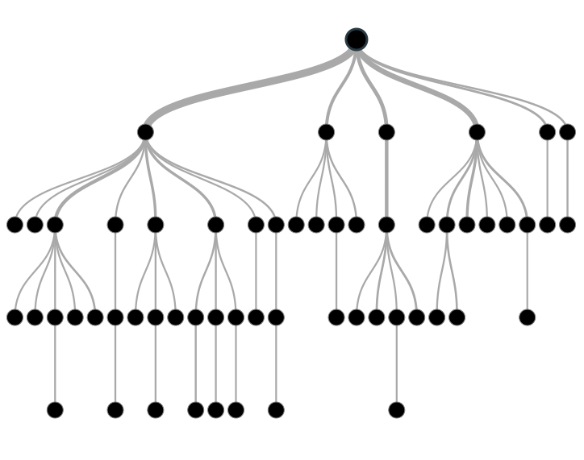
What are Tree-Based Models
Introduction
Definition: Tree-based models are a class of machine learning algorithms that use a tree-like structure for decision-making.
Key Features:
Non-linear data modeling.
Intuitive and interpretable results.
Handle both categorical and continuous variables.

Slide 4
Decision Trees
Introduction :
- Decision Trees are a supervised machine learning algorithm simulating human decision-making.
- They handle categorical data effectively, unlike many other ML algorithms.
- Capable of modeling complex, nonlinear relationships between independent and target variables.
- Popular for their simplicity and clarity, making them easily interpretable for business users.
- The model functions as a tree structure, making predictions based on a series of questions.
- Data is split based on the most important attributes, forming multiway decision trees when divided into multiple partitions.

Slide 5
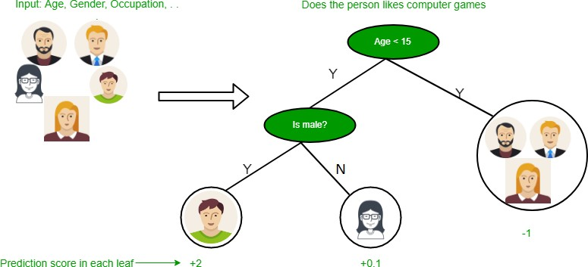
Example of Decision Tree
Here the first split he based on Age, we will discuss further how the split is made on Age

Slide 6
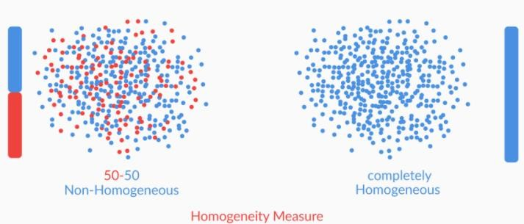
Algorithms of Decision Tree
Homogeneity Measures :
Suppose we have a dataset of 8 attributes, we can’t randomly select a attribute to split the data. There is a selection criterion to choose the attributes, which is call Homogeneity Measure. We are going to pick the attribute which as more Homogeneity Measure. Lets see the fig below to understand better about Homogeneity .

Slide 7

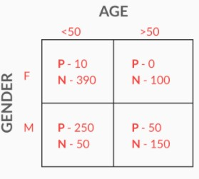
Gini Index
The Homogeneity Measure can be calculate using the Gini index, if the Gini index of an attribute is equal to 1 then the Homogeneity of that attribute is high.
Formula for Gini Index :
Key point: Gini = 1 Homogeneity is high if Gini = 0 less Homogeneity
Lets see the example how to calculate Gini Index:
Lets first split the data set on Gender:
Gini Index(gender) = (fraction of total observations in male)*Gini index of male + (fraction of total observations in female)*Gini index of female.
=1/2((1/50)*2+ (49/50)*2) +1/2((3/5)*2+ (2/5)*2) = 0.74
Split on Age:
= 0.7((26/70)*2+ (44/70)*2) + 0.3 ((1/6)*2+ (5/6)*2) = 0.59
So the Gini Index for Gender is close to 1 so that we can split on Gender.
P = playing, N = Not playing

Slide 8
Entropy and Information Gained
Entropy quantifies the degree of disorder in the given data. Entropy ranges from 0 to 1 if Entropy =0 that means data has high Homogeneity
Formula for entropy :
Where pi = Probability of finding label i k = Number of different labels ε[D] = Entropy of Dataset D
Information Gained Measures how much as the entropy decreases after splitting the data Formula for Information Gained
Where ε[D]
ε[DA]
= Entropy of parent set
= Entropy of Partitions Obtained after splitting
ε[DA=i] = Entropy of Partitions where value of attribute A for the data points is i DA=i = Number of points where attribute A is i
K = Number of different labels

Slide 9
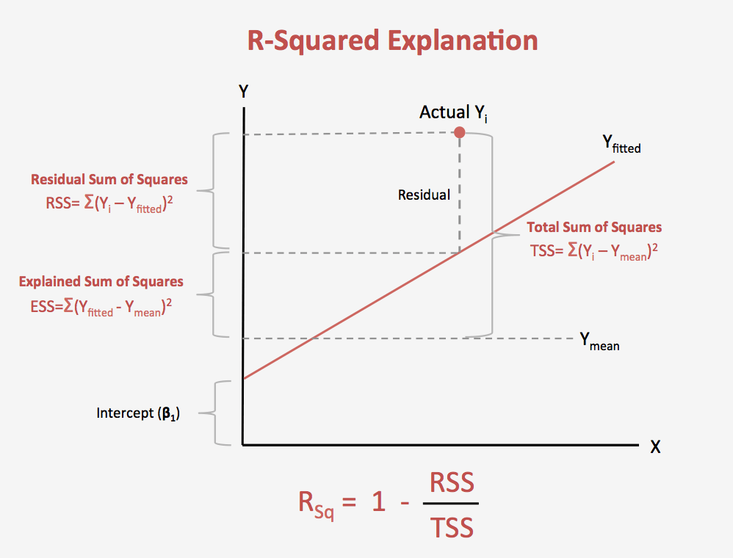
Splitting by R-squared
R-squared is calculated when there are continuous variables in the data. It is calculated in similar way how we work on a Regression model. To Split the date R-squared value should be greater than the original data
Formula for R-squared: 1- (RSS/TSS)
Where RSS = Residual Standard Error TSS = Total sum of squares

Slide 10
Hyperparameters
Scikit-learn provides some functionalities or parameters that are to be used with a Decision Tree classifier to enhance the model’s accuracy in accordance with the given data.
criterion: This parameter is used to measure the quality of the split. The default value for this parameter is set to “Gini”. If you want the measure to be calculated by entropy gain, you can change this parameter to “entropy”.
splitter: This parameter is used to choose the split at each node. If you want the sub-trees to have the best split, you can set this parameter to “best”. We can also have a random split for which the value “random” is set.
max-depth: This is an integer parameter through which we can limit the depth of the tree. The default value for this parameter is set to None.
min_samples_split: This parameter is used to define the minimum number of samples required to split an internal node.
max_leaf_nodes: The default value of max_leaf_nodes is set to None. This parameter is used to grow a tree with max_leaf_nodes in best-first fashion.

Slide 11
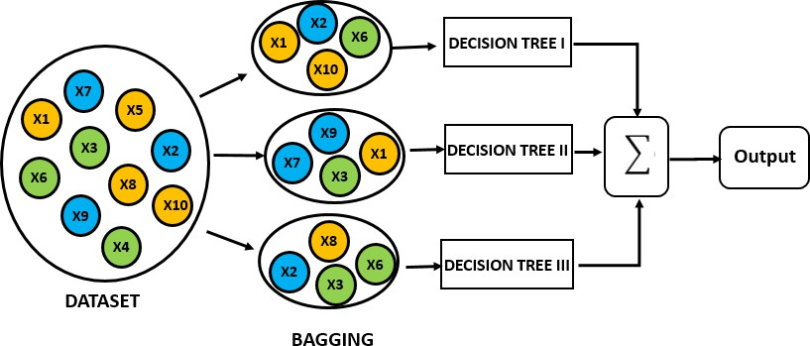
Random Forest
To start learning about Random Forest, we should first know about the Ensembles.
Ensembles :
It means group of things viewed as whole rather than individually. They use a group of models to make prediction, unlike Decision Tree. Random forest is the most popular ensemble technique. Ensemble made by combinations of large number of decision trees. In Random forest Bagging technique is used which is a Ensemble method. Lets see the figure below how its work.

Slide 12
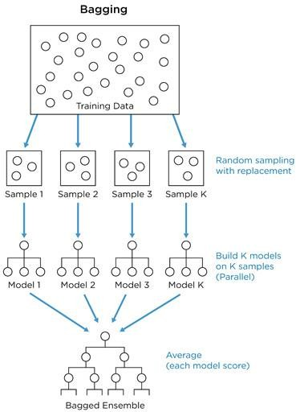
Creating Random Forest
Random Forest are having nearly same hyper parameters as Decision Tree. It is a collection of decision trees. Random Forest is created uses bagging (bootstrapped aggregation) as we discussed it’s a ensemble technique. bagging is for choosing Random Samples from the given data and each set of samples trained in each tree in a Random forest.
The figure illustrates the total flow of Random forest:
From the training data random bootstrap samples are taken.
One Bootstrap sample contain 30-70% data form the dataset.
The Decision Trees are creates on each Bootstrap sample.
Finally we will take the Majority scores of all the predictions.

Slide 13
OOB(out-of-Bag) Error
OOB error is same as cross validation error. It is calculated by using each data point of training data as test point. While Bootstrap samples are taken there may be several Decision trees does not include some data points, which means that data point is unseen for that particular tree.
Lets take an example:
we have 200 data point and build Random Forest with 40 decision trees, with each tree contain 25 data points. We found that 15 trees does not have a data point “i” but still predicted the data point . Assume that 10 predicted as 0 and 5 predicted as 1. The final output will be taken as 0.
So OOB error is calculated as number of data points predicted wrongly as proportion of total number of data points.

Slide 14
Advantages of Random Forest
Can Parallelize the training of forest, because each tree is constructed independently.
Random forest is more stable than a single decision tree,
Random forest is immune to the curse of dimensionality.
We can calculate OOB error using training data, which gives a correct view of random forest on unseen data.

Slide 15
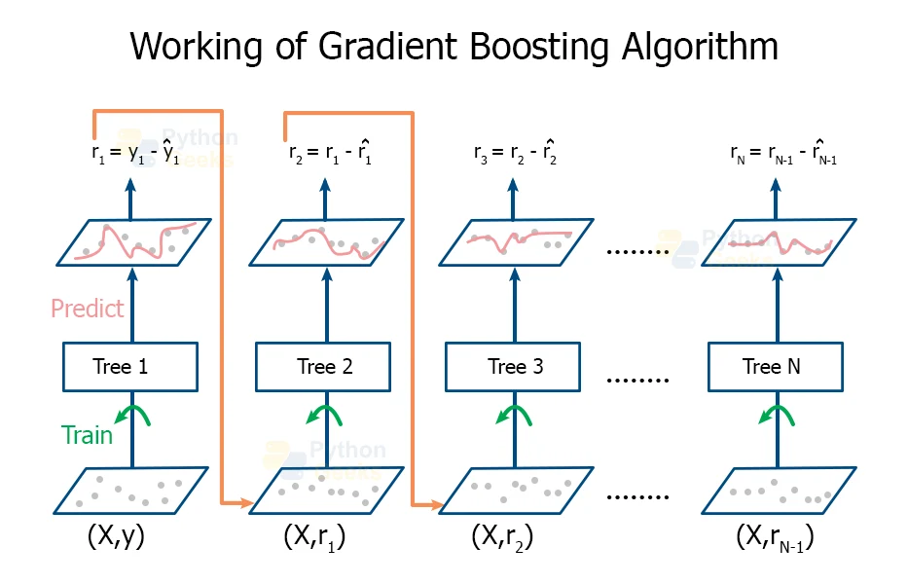
Gradient Boosting - Basic Concept
*Example*: Predicting whether a person buys a product based on income and age.
Show a simple decision tree diagram with splitting nodes based on income, age, and purchase decision at the leaf nodes.
l
What is Gradient Boosting?
An ensemble method that builds trees sequentially, where each new tree corrects the errors made by the previous trees.
Unlike random forests, gradient boosting focuses on minimizing the errors (residuals) of previous predictions.
Key Algorithms:
XGBoost
LightGBM
CatBoost
How it works:
Train a base model (tree) on the residuals from the previous model.
Repeat until the model reaches a certain number of iterations or error threshold.

Slide 16
Adaboost
- AdaBoost is an advanced ensemble learning model that uses a boosting algorithm to improve performance by iteratively training weak classifiers on different subsets of training data.
- It assigns higher weights to misclassified samples in each iteration, allowing subsequent classifiers to focus on challenging examples.
- The main goal of AdaBoost is to reduce error by combining multiple weak models into a single strong model.

Slide 17
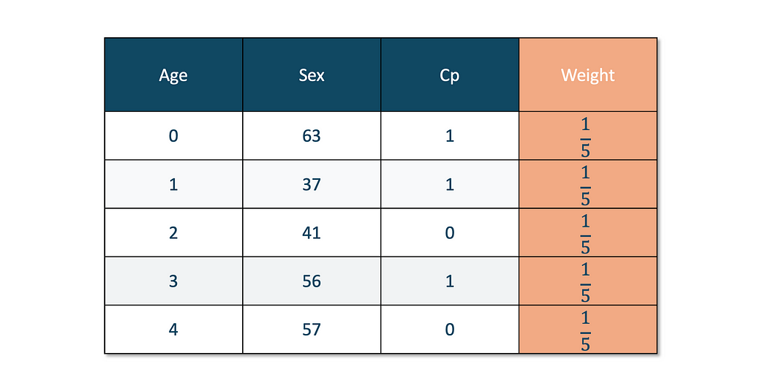
How Does The AdaBoost Work?
We can understand the working of the AdaBoost algorithm in step by step manner as going deep into the work, we can see there are multiple basic steps which this algorithm follows. Let’s take a look at these steps.
Initially, the algorithm starts with taking all the observations and giving them equal weights.
Here, equal weights are given for each of the observations. 1/5 because we have five observations. and the equal value will be 1/5 for each of them.

Slide 18
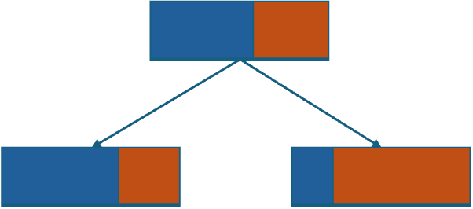
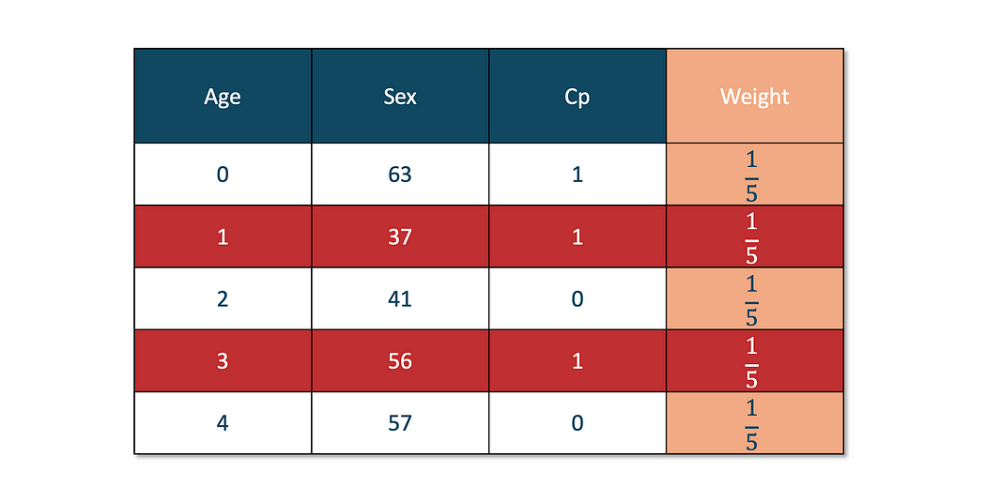
2. We create our first weak learner using a Decision Tree. In AdaBoost, a decision tree with a depth of 1 is used.
Here, a decision stump is created for each feature — age, sex, cp — and then, based on the value of the criterion(entropy, gini, mean absolute error, etc.), we will choose our first decision stump.
3. At this step, we calculate the Total Error and Performance of the stump.
This decision tree with depth 1 is called Decision Stump.

Slide 19
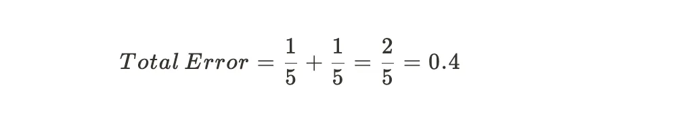
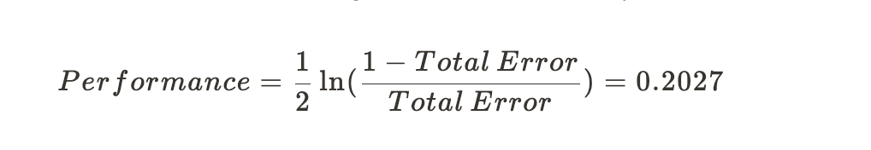
If the red-colored observations are incorrectly predicted by our base learner, then our total error will be:
Now, the Performance (also denoted as α(alpha)) of the stump is calculated by:
After putting the value of Total Error, we get the Performance value of 0.2027.
4. Now, we update the weight of each of the observations.In order to update the weight, we use two different formulas: one for correctly predicted observation and one for incorrectly predicted observation.
Updated weight for:
Incorrectly predicted observation

Slide 20
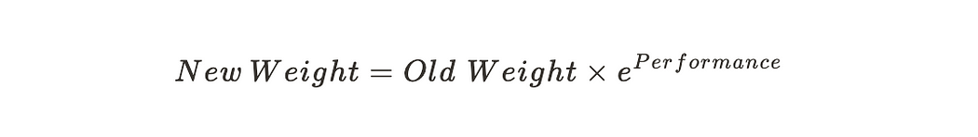
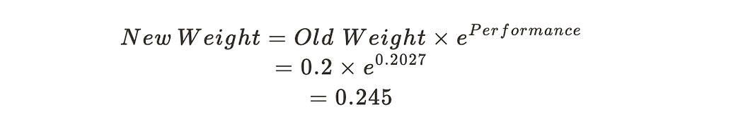
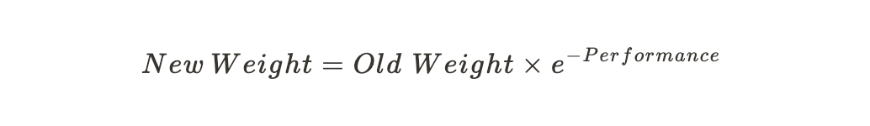
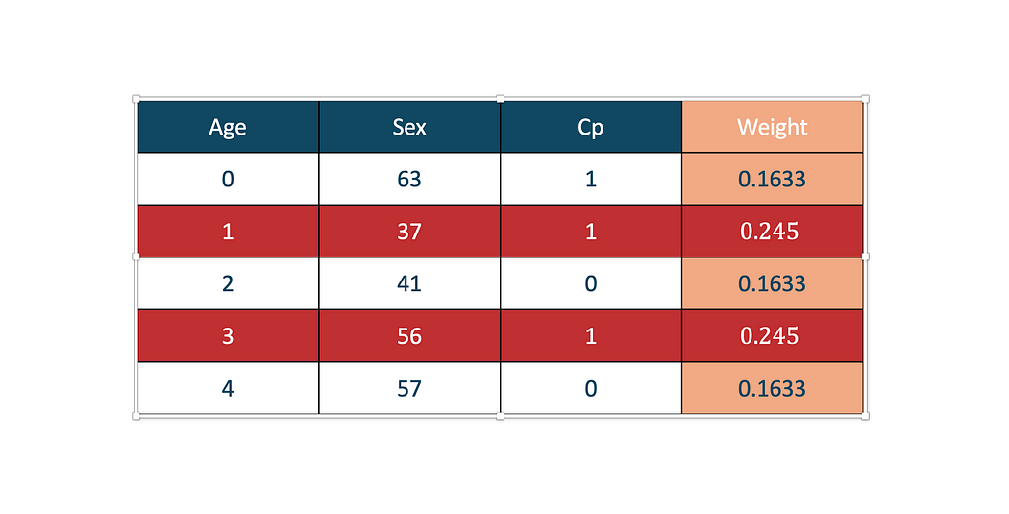
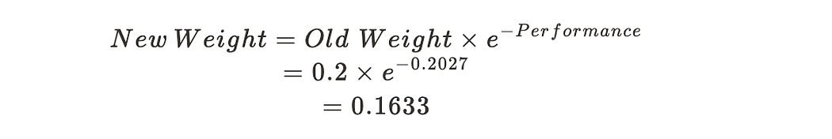
Lets see an example:
Correctly predicted observation
Lets see an example:
As you can see, the value of the new weight is increased from 0.2 to 0.245
The reason is to increase the weight for the incorrectly predicted observation so that they can be passed to the next base learner.

Slide 21
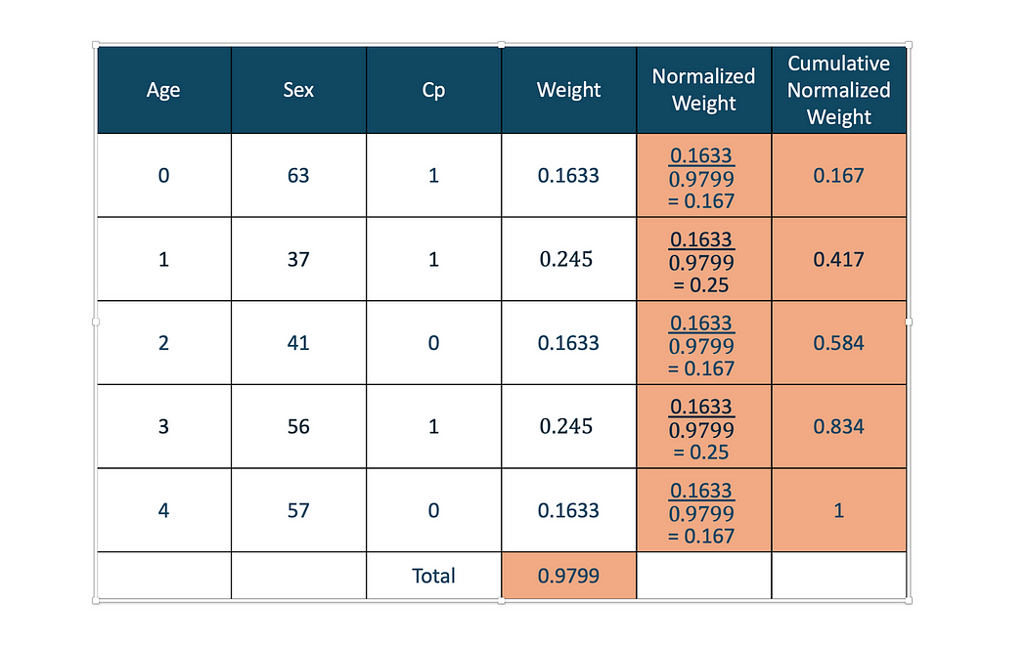
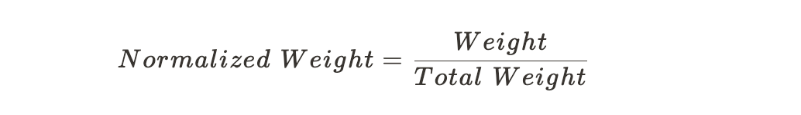
5. Now, we have to find a Normalized Weight to ensure the total weight is equal to 1. Then, we calculate the Cumulative Normalized Weight
As you can see in the table above, Normalized weight is calculated by
and Cumulative Normalized weight is just adding the normalized weight.
The idea behind creating the Cumulative Normalized weight is to create different Bins.
From the above table, we can see that we have five bins

Slide 22
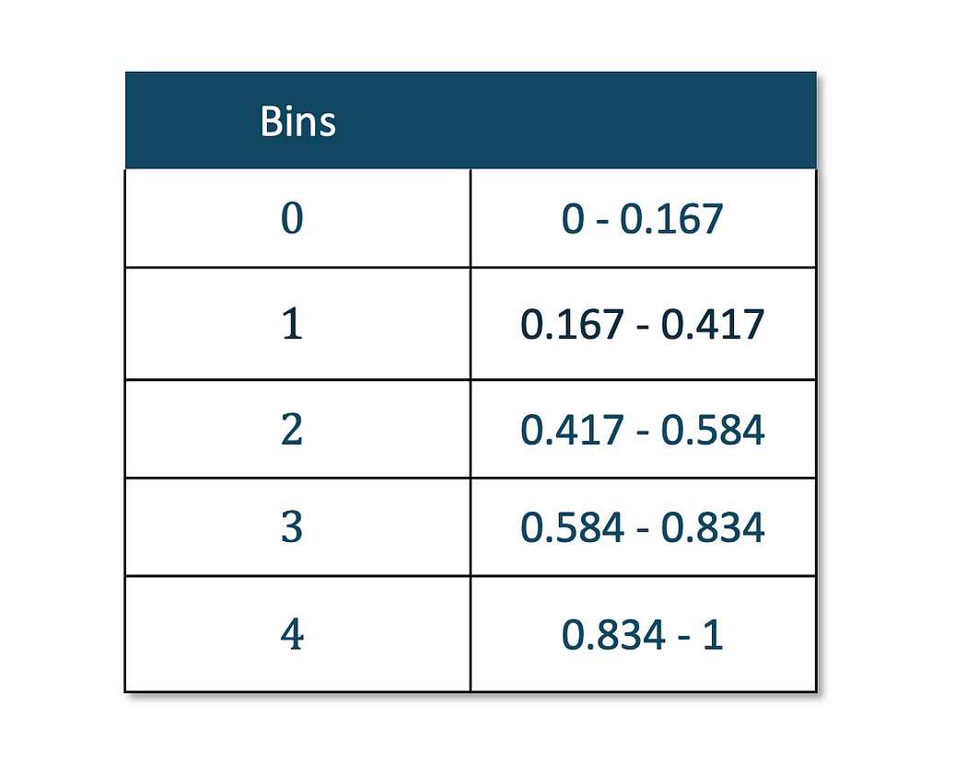
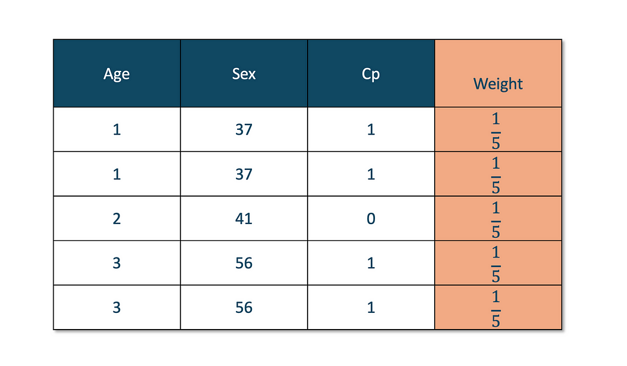
According to this bin list, a New Dataset is created that the next Base Learner can use.
6. Creating a New Dataset
This is where it gets interesting. To create a new dataset, we find random values between 0 and 1. The total number of random values should be equal to the total number of observations.
We have 5 observations, so we will choose five random values. Let’s say they are,
[0.25,0.4.0.5,0.35,0.82]
Most of the time, the incorrectly classified observation will be selected after creating the bins. Since the bins that contain incorrectly predicted observations have a larger range, the probability of it being selected is higher.
Now, we see where all those values fall in.
After looking at the bins table, We get these values [1,1,2,1,3]
Now our new dataset will be:
Based on this data, we will repeat the process and proceed with Next Base Learner.
The final prediction is obtained by aggregating the predictions of all weak classifiers based on their weights.

Slide 23
Gradient Boosting - Pros and Cons
Pros:
Highly accurate due to sequential correction of errors.
Can handle complex datasets and interactions between features.
Works well with small to medium-sized datasets.
Cons:
Prone to overfitting if not tuned properly.
Slower to train compared to random forests.
Difficult to interpret (less interpretable than individual decision trees).

Slide 24
Comparison - Decision Trees, Random Forest, and Gradient Boosting
*Model* | *Pros* | *Cons* | *Best Use Cases*
Decision Trees | Simple, Interpretable | Overfitting, unstable | Small datasets, interpretable tasks
Random Forest | Reduces overfitting, robust | Computationally expensive, less interpretable | Large datasets, high-dimensional data
Gradient Boosting | High accuracy, effective with complex data | Slow training, Hard to tune | Complex datasets, competitive models

Slide 25
Hyperparameter Tuning in Tree-Based Models
Decision Trees: Max depth, min samples split, min samples leaf, max features.
Random Forest: Number of trees, max depth, min samples split, max features.
Gradient Boosting: Learning rate, number of estimators, max depth, subsample.

Slide 26

Thank you

